Slide 1
Lecture 1 – Multivariate linear models
AI in Genetics
ZOO6927 / BOT6935 / ZOO4926

Slide 2
Vectors, matrices, and tensors

Slide 3
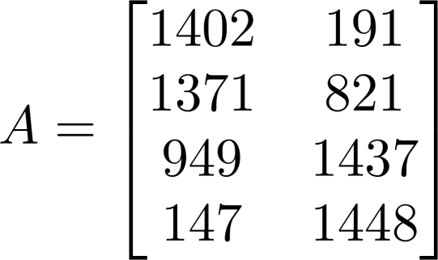
Matrix: Rectangular array of numbers:
Dimension of matrix: number of rows x number of columns
Dim(A) = 4 x 2

Slide 4
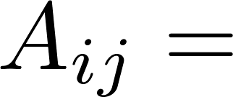

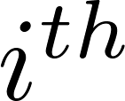

Matrix Elements (entries of matrix)
“ , entry” in the row, column.

Slide 5
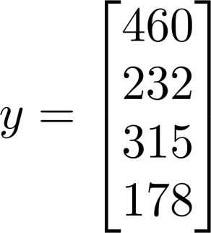
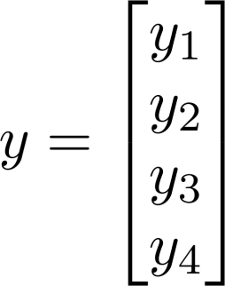
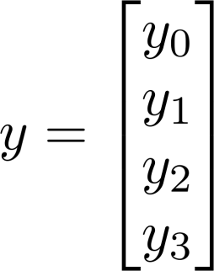
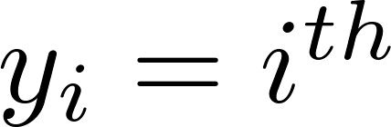
Vector: An n x 1 matrix.
1-indexed vs 0-indexed:
element
n-dimensional vector

Slide 6
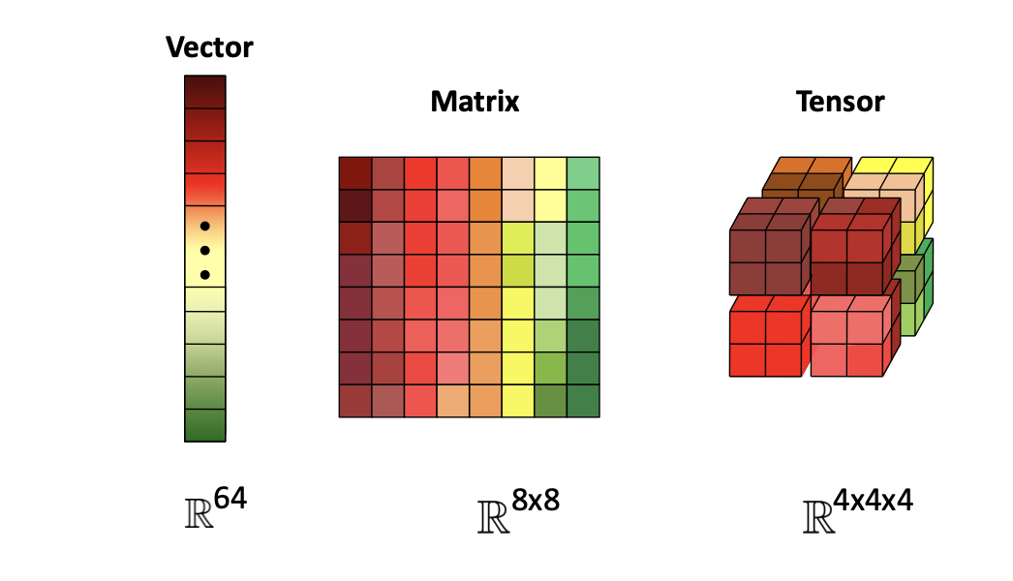
Tensor: High-dimensional array

Slide 7
Basic matrix algebra

Slide 8
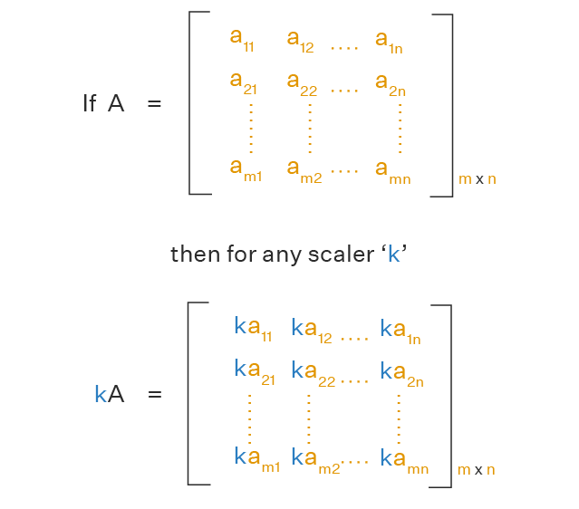
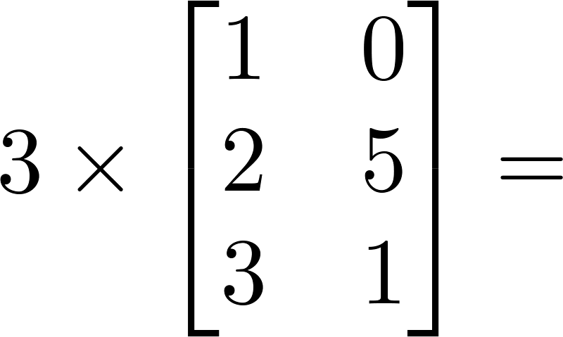
Scalar Multiplication

Slide 9
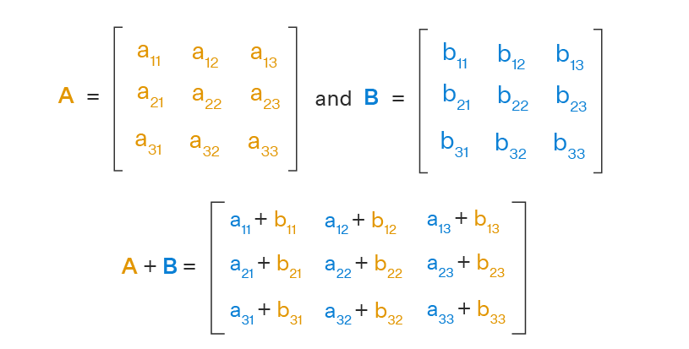
Matrix Addition is element-wise

Slide 10
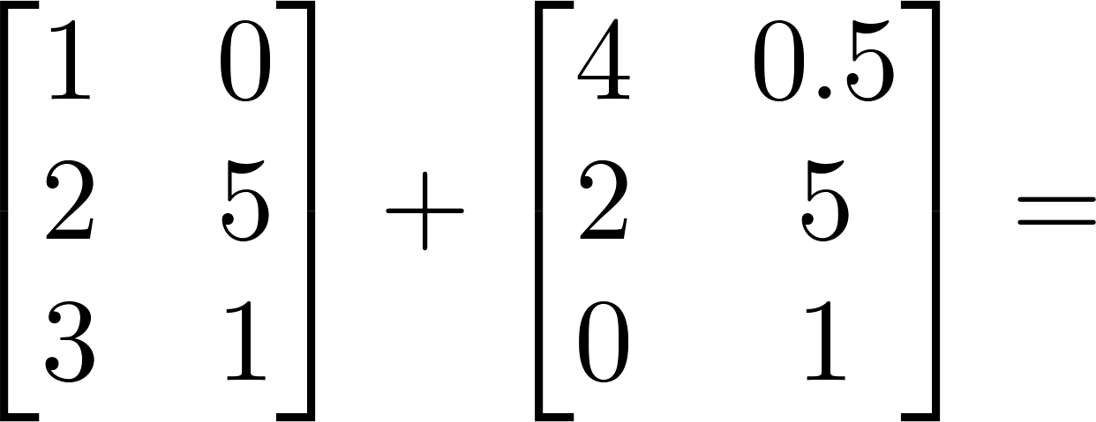
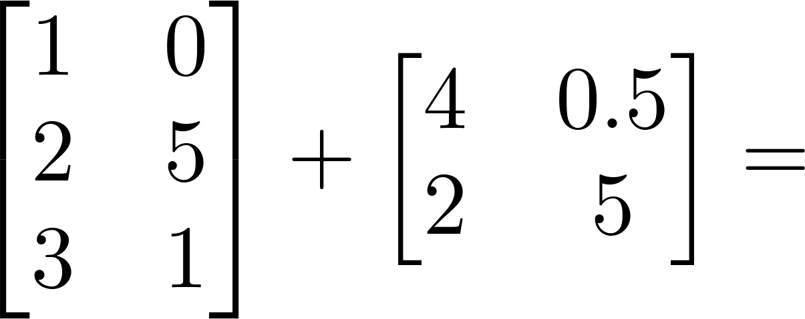

Slide 11
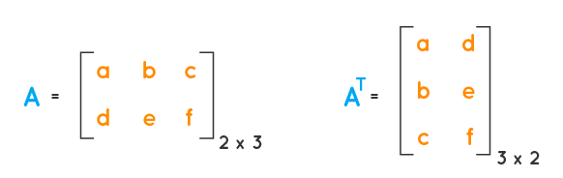
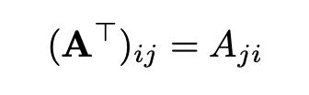
Matrix transpose

Slide 12
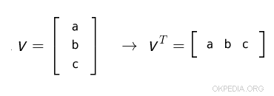
Transposing a column vector results in a row vector, and vice versa

Slide 13
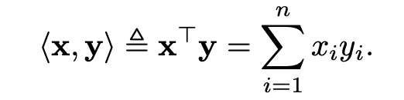
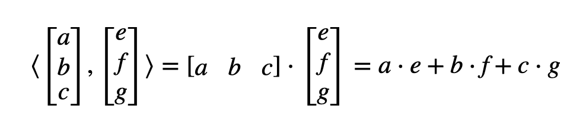
Vector-Vector Product
“Inner product” or “dot product”

Slide 14
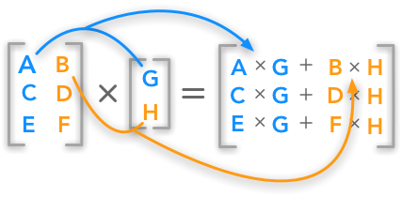
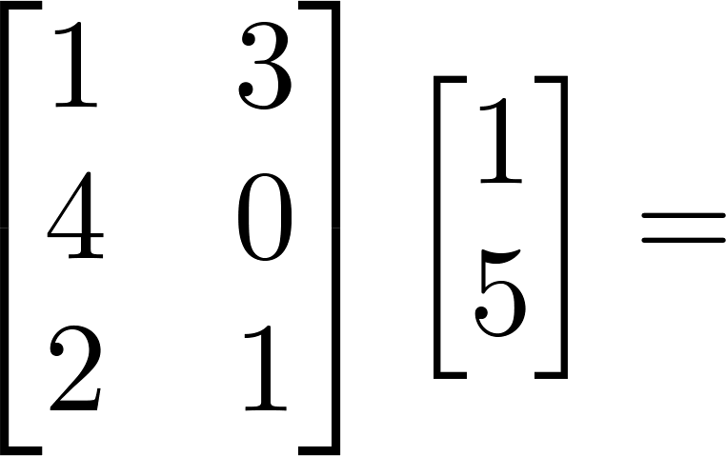
Matrix-vector multiplication

Slide 15
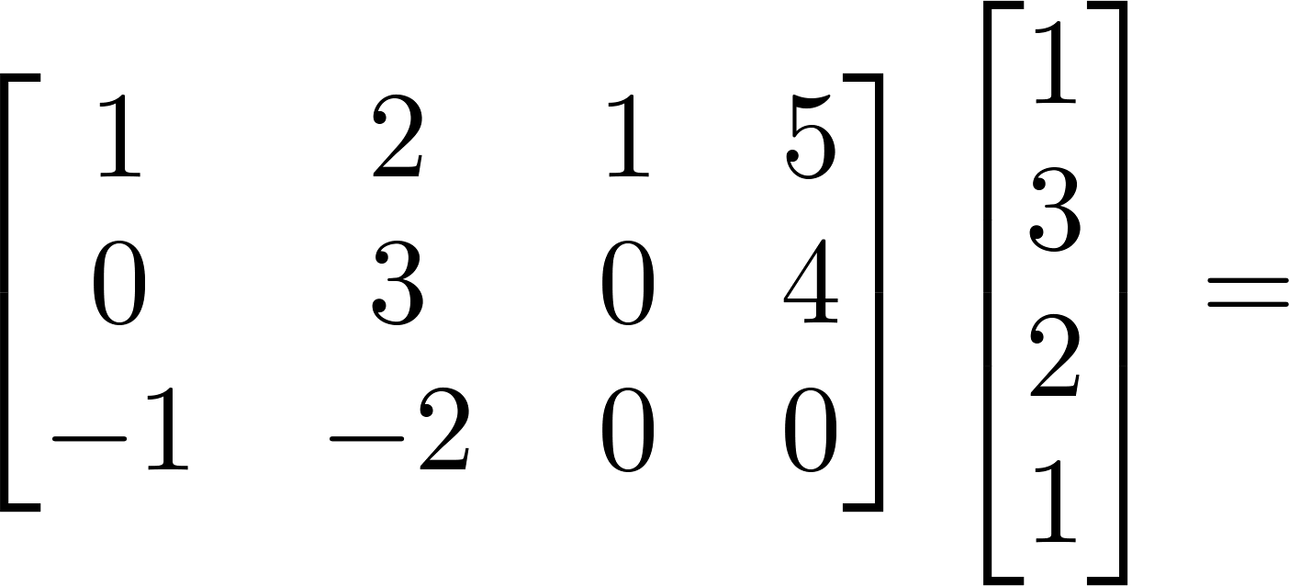
Example

Slide 16
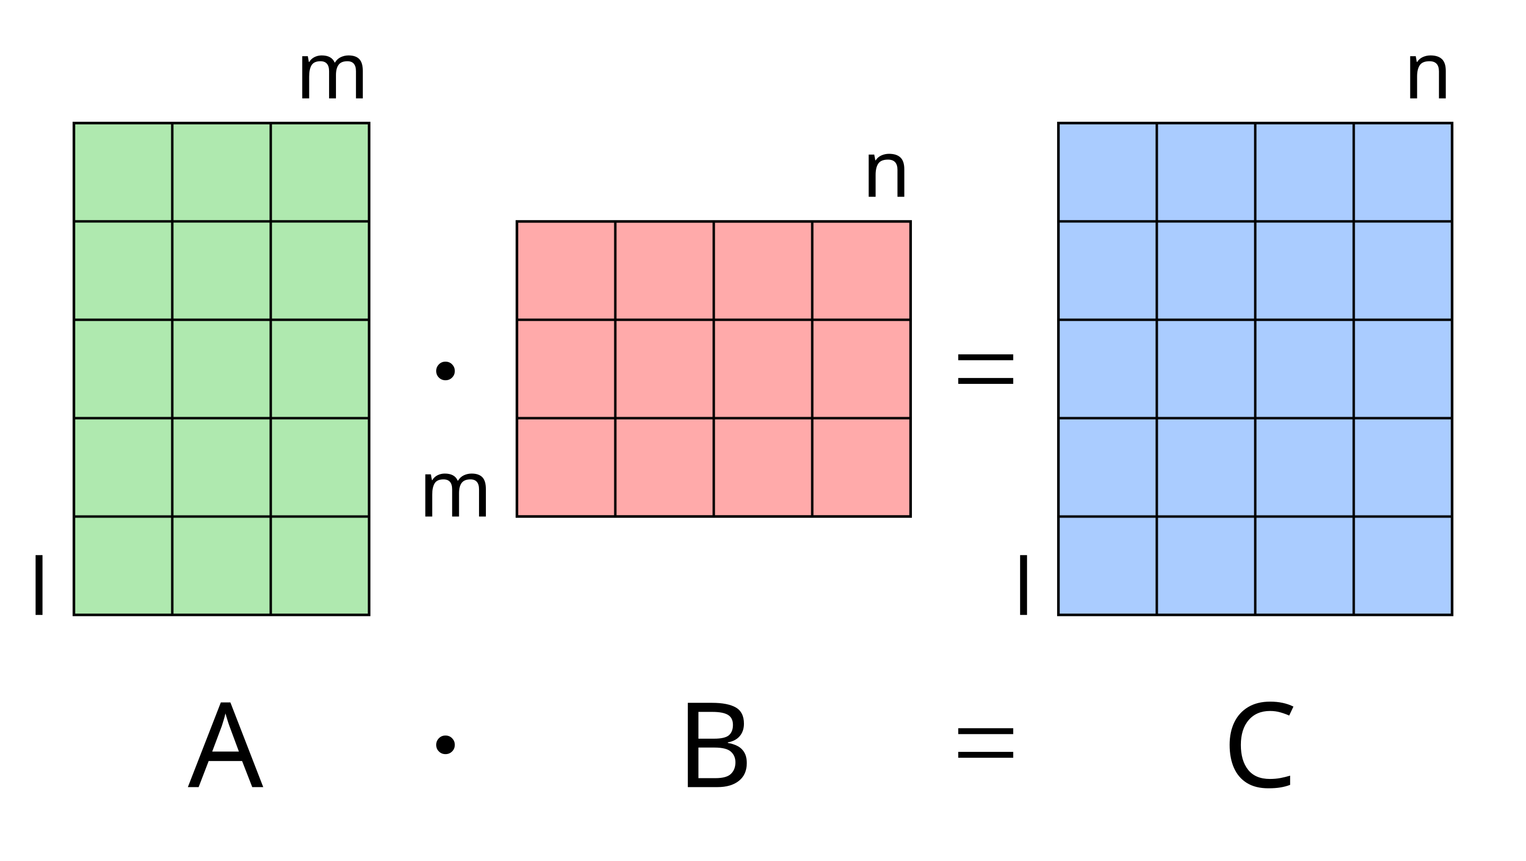
Matrix-Matrix Product

Slide 17



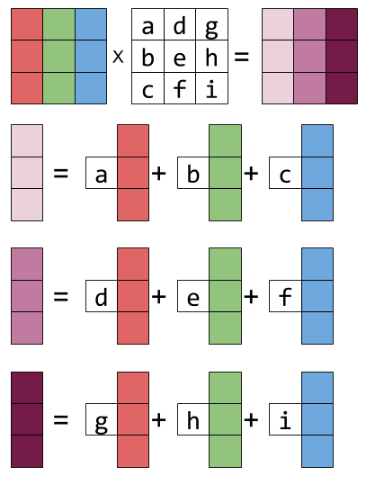
Matrix-Matrix Product
The i-th column of the matrix C is obtained by multiplying A with the i column of B

Slide 18
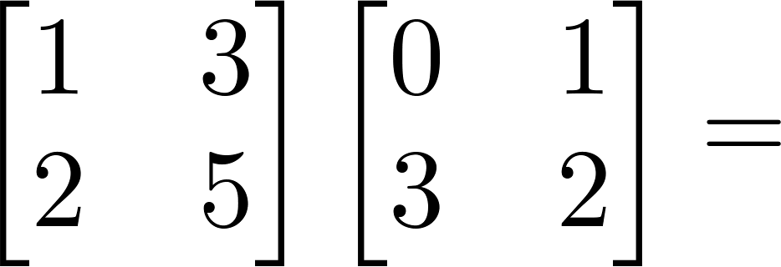
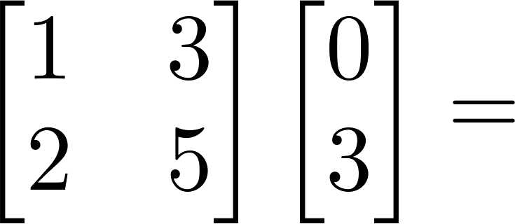
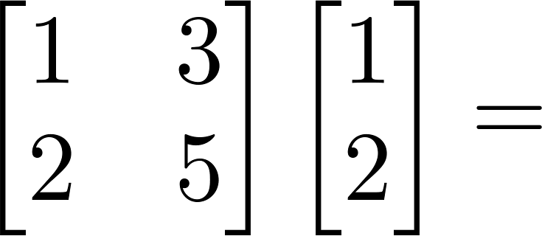
Example

Slide 19
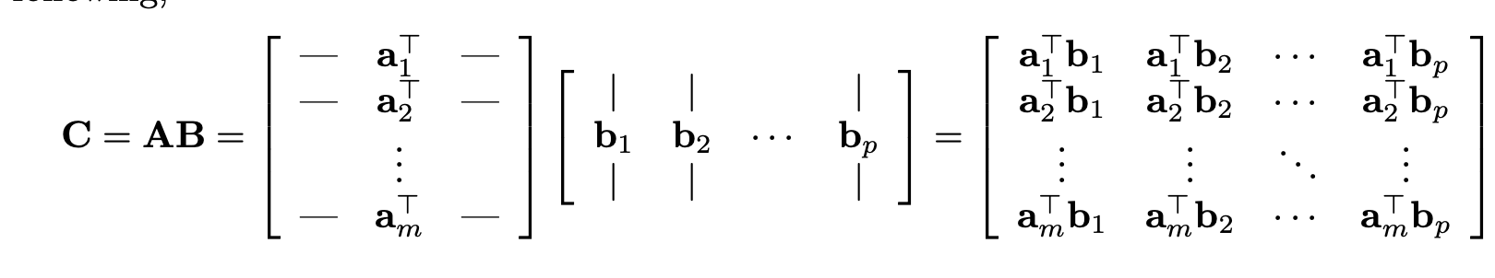
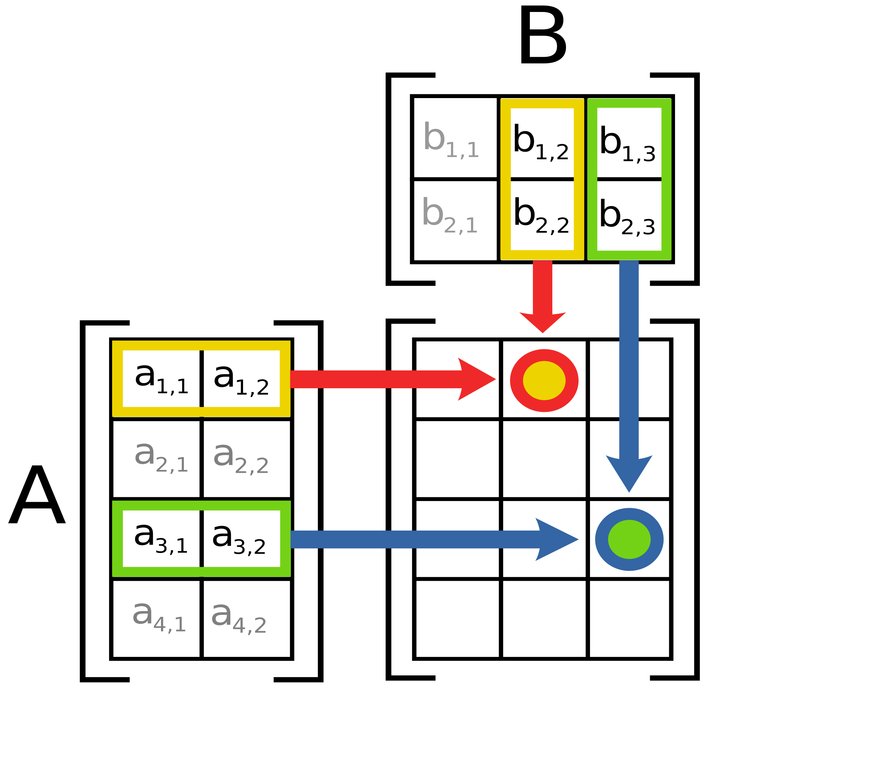
C
The I,j-th element of the matrix C is the dot product of the i-th row of A with the j-th column of B

Slide 20
A and B must have conforming dimensions!
Dim(A) = m x n
Dim(B) = n x p
Dim(AB) = m x p

Slide 21
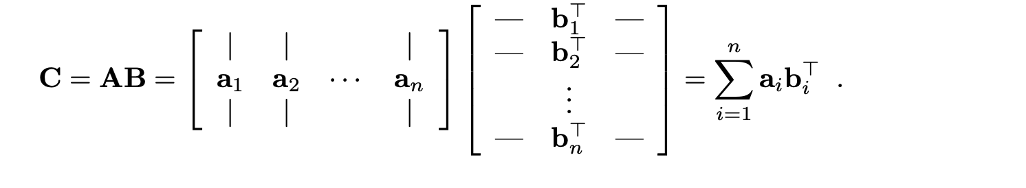
*The matrix C is the sum of outer product of i-th column of A and i-th row of B

Slide 22
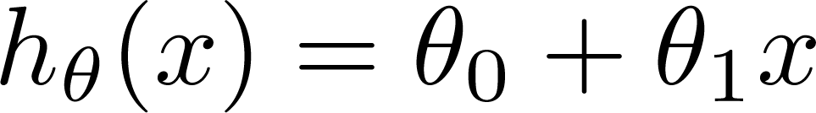
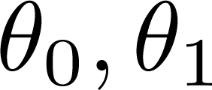
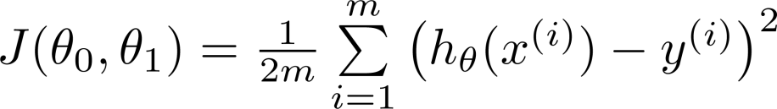
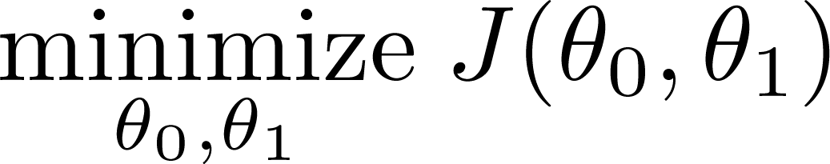
Back to the simple linear regression example
Hypothesis:
House sizes:
Size in feet² (x) | Price ($) in 1000's (y)
2104 | 460
1416 | 232
1534 | 315
852 | 178
… | …
Parameters:
Cost Function (MSE):
Goal:

Slide 23
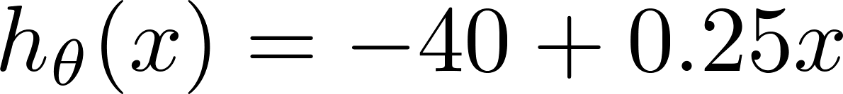
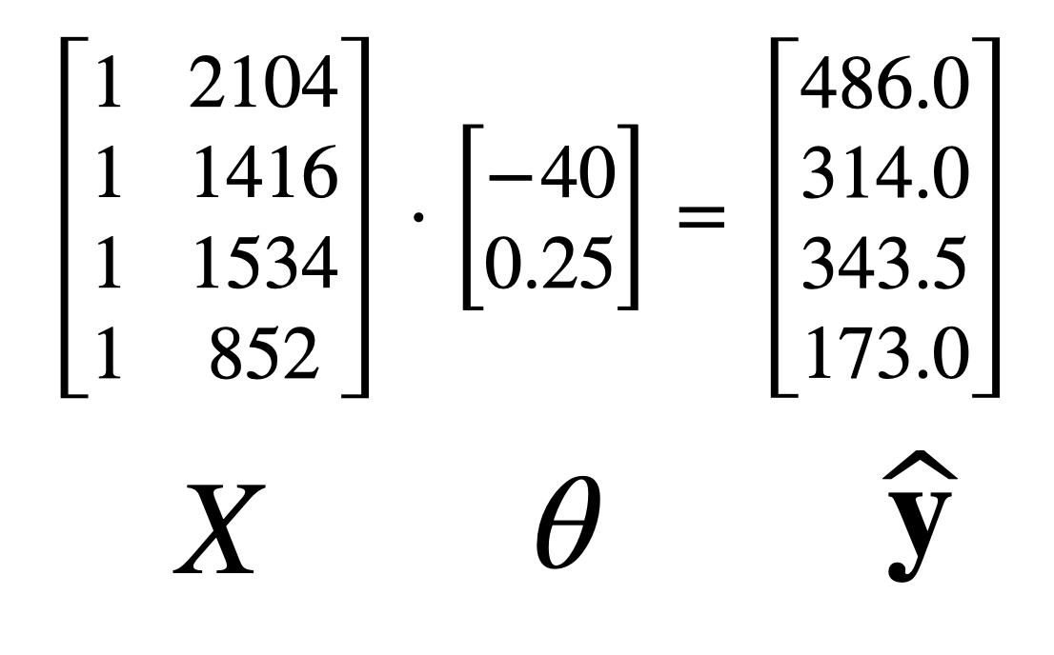
House sizes:
Hypothesis:
Size in feet² (x) | Price ($) in 1000's (y)
2104 | 460
1416 | 232
1534 | 315
852 | 178
… | …
Use matrix-vector multiplication:

Slide 24
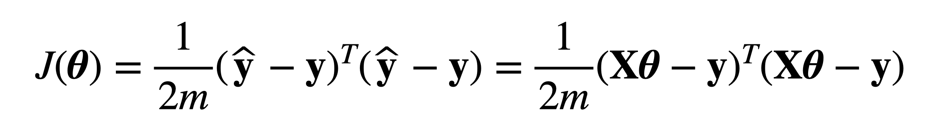
Model prediction
House sizes:
Size in feet² (x) | Price ($) in 1000's (y)
2104 | 460
1416 | 232
1534 | 315
852 | 178
… | …
Cost

Slide 25
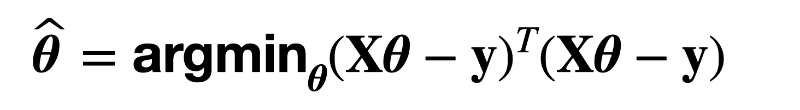
Model prediction
Goal:
Solution
Cost

Slide 26
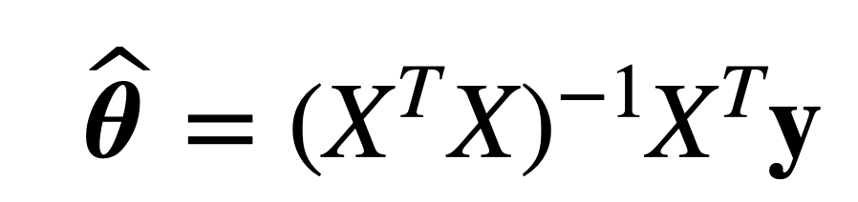
How to find the solution - calculus

Slide 27
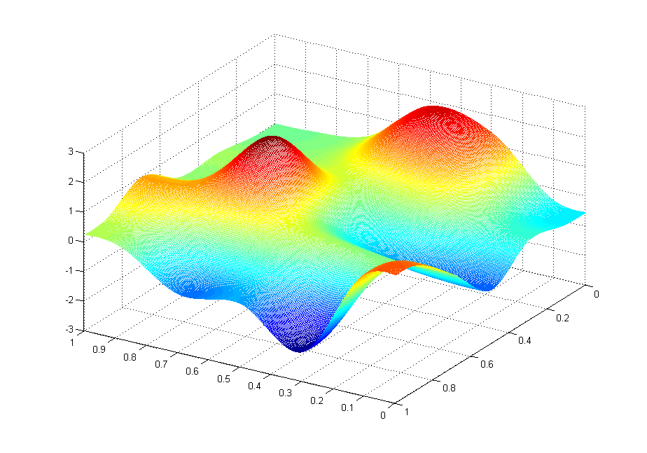
How to find the solution – gradient descent
J(θ₀,θ₁)
θ₁
θ₀

Slide 28
Broadcasting
Broadcasting: how NumPy (torch, tensorflow) treats arrays with different shapes during arithmetic operations.
When performing operations between two arrays, broadcasting automatically expands one or both arrays so they have compatible shapes. This allows element-wise operations without the need for explicitly reshaping arrays.

Slide 29
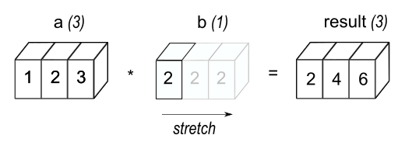
Generalized tensor operation: Broadcasting

Slide 30
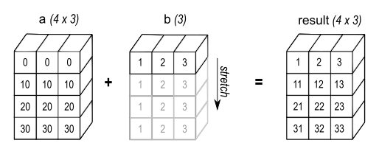

Slide 31
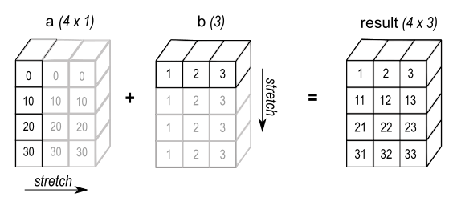

Slide 32
Concise Code: It reduces the need for explicit loops and reshaping, making the code more concise and easier to read.
Performance: Broadcasting is implemented in a memory-efficient manner, avoiding unnecessary copies of data.
Flexibility: It allows operations on arrays of different shapes without needing them to be exactly the same size.

